Slide 1
Facial Recognition using Python & OpenCV
Project Based Learning SEM-3

Slide 2
Face Detection
In computer vision, one essential problem we are trying to figure out is to automatically detect objects in an image without human intervention. Face detection can be thought of as such a problem where we detect human faces in an image.
There may be slight differences in the faces of humans but overall, it is safe to say that there are certain features that are associated with all the human faces.
There are various face detection algorithms but Viola-Jones Algorithm is one of the oldest methods that is also used today.
Face detection is usually the first step towards many face-related technologies, such as face recognition or verification. However, face detection can have very useful applications.
The most successful application of face detection would probably be photo taking. When you take a photo of your friends, the face detection algorithm built into your digital camera detects where the faces are and adjusts the focus accordingly.

Slide 3
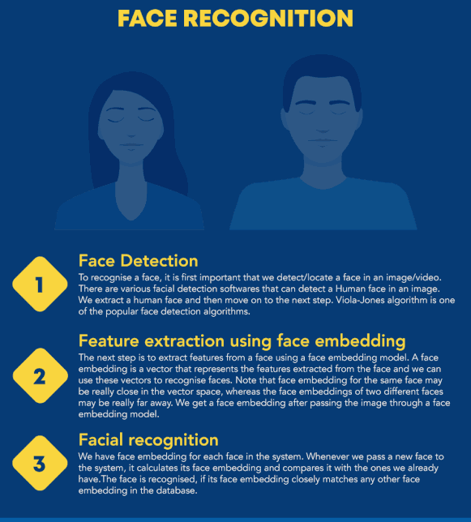
As mentioned in the given image, it is first important to detect and locate a human face. After detecting a face we move on to the Viola-Jones Algorithm.
The next step is to extract features using face embedding models. A face embedding is a vector that represents the features extracted and can be used to save a dn recognise faces.
After we have facial embedding for each face in the system we can compare it with the passed test case by calculating its face embedding with the one we already have. The face is recognised if its embedding is closely matched with the one in the system.

Slide 4
Face Recognition
Face recognition is a method of identifying or verifying the identity of an individual using their face.We make use of face embedding in which each face is converted into a vector and this technique is called deep metric learning.
Face Detection: The very first task we perform is detecting faces in the image or video stream. Now that we know the exact location/coordinates of face, we extract this face for further processing ahead.
Feature Extraction: Now that we have cropped the face out of the image, we extract features from it. Here we are going to use face embeddings to extract the features out of the face. A neural network takes an image of the person’s face as input and outputs a vector which represents the most important features of a face. In machine learning, this vector is called embedding and thus we call this vector as face embedding.
Comparing faces: Now that we have face embeddings for every face in our data saved in a file, the next step is to recognise a new t image that is not in our data. So the first step is to compute the face embedding for the image using the same network we used above and then compare this embedding with the rest of the embeddings we have. We recognise the face if the generated embedding is closer or similar to any other embedding

Slide 5
OpenCV
OpenCV is an open-source computer vision library. It is supported by various programming languages such as R, Python. It runs on most of the platforms such as Windows, Linux and MacOS.
Advantages of OpenCV:
OpenCV is an open-source library and is free of cost.
As compared to other libraries, it is fast since it is written in C/C++.
It works better on System with lesser RAM
It supports most of the Operating Systems such as Windows, Linux and MacOS.

